Slide 1

S&P 500 Price Prediction
Jeungsoo Noh

Slide 2
Problem Statement
In this project, I aimed to predict the next-day closing price of the S&P 500 index using historical stock data.
The input is a set of technical indicators derived from past prices — like moving averages, momentum (how fast the price is changing) indicators, and volatility measures.
The output is a predicted closing price for the following trading day.
The motivation: If we can predict market trends even modestly well, this could have real value in finance and risk management. Wanted to test out several models learned in class.
Data is from Nasdaq

Slide 3
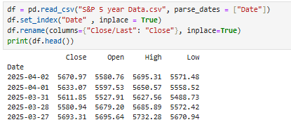
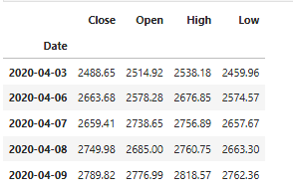
Data

Slide 4
Features
SMA(simple moving average) and EMA (Exponential moving average)
EMA focuses on most recent weight
MACD(short-term and long-term EMA) and Signal Line(Smoothed version of MACD)
Bollinger Bands(high and low) for volatility
RSI (Momentum indicator that tells whether stock is overbought or oversold)
Overbought→ price increased too quick
Raw price features: Open, High, Low

Slide 5
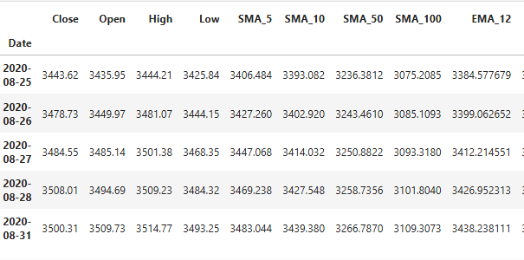
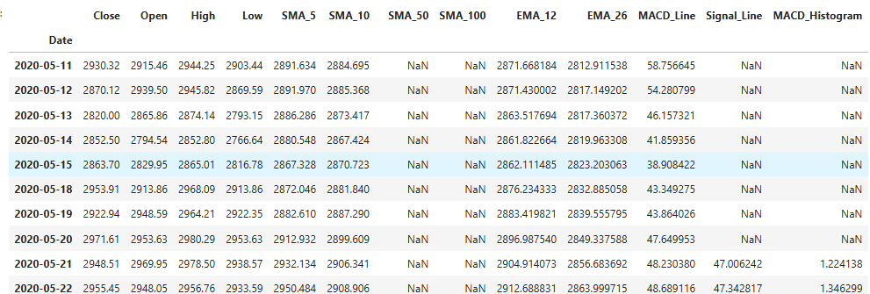
Data Preprocessing
Dealing with missing data: SMA 100 is empty for first 100 days, EMA 26 is empty for first 26 days to be calculated →
began calculating after 100 days instead of using SimpleImputer.
SimpleImputer duplicated the values until the calculation( for SMA_100, 99 row had same values)

Slide 6
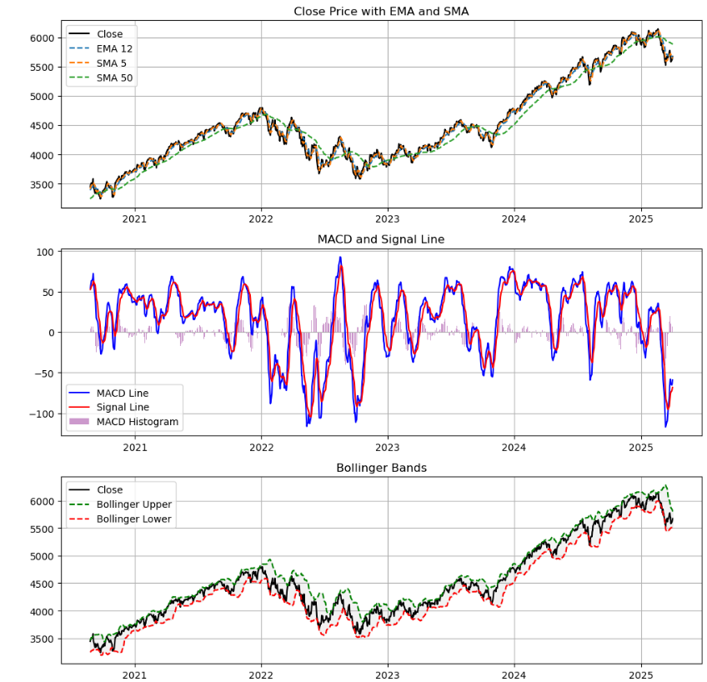
Visualization after Data preprocessing
EMA tells how recent price is moving.
MACD line > signal line = Buy signal, and vice versa for other way around.
Bollinger tells how volatile the price is.

Slide 7
Algorithm used
Linear Regression
Random Forest
XGBoost
Support Vector Regression(SVR)

Slide 8
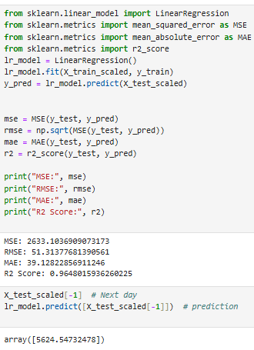
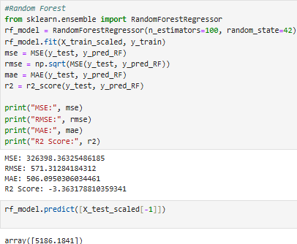
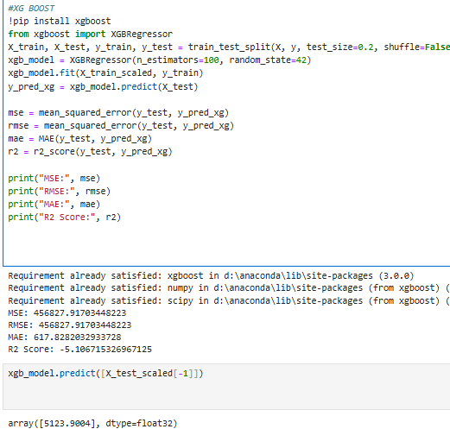
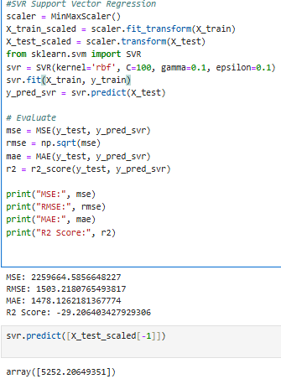
Results
The actual closing price of April 3rd was 5492.74

Slide 9
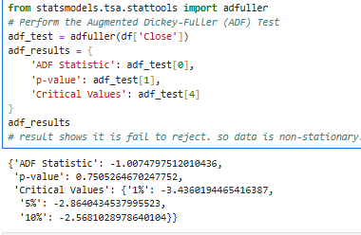
Results
Linear Regression achieved an R² score of 0.965, meaning it could explain over 96% of the variance in the next-day price. The MAE was around 39, which is quite reasonable for financial data.
Random Forest and XGBoost severely underfit the data, with R² scores below 0.
SVR, even after scaling, still failed to generalize, possibly due to overfitting or sensitivity to hyperparameters. It failed the worst
I manually set the C, gamma and epsilon for SVR
I used GridSearchCV to tune hyperparameters. It evaluated 32 combinations, each with 3-fold cross-validation, so a total of 96 models were trained.
All models treated the input features like static data, not time-series.
Stock price is non-stationary, so mean and trend change over time.
Maybe that is why it led to failure.

Slide 10
Future direction
Even simple model like Linear Regression can somewhat perform well.
Due to efficient market hypothesis, it still will be hard to predict the stock price. Stock prices reflect all information, public and private.
Effect of noise is huge in the stock market. “Trump’s word on anything can change the market easily”
Perhaps using time series model such as LSTM(Long Short-Term Memory) model might help but it may not be the accurate algorithm to predict (I was not proficient enough to do it)

